Slide 1
Talkin’ Bout
The Population
Analysis of World Population
Notes:
We are comparing the GDP and population of different countries across several decades and creating a dashboard page with multiple charts that update from the same data.
Juhita

Slide 2
Our Team:
Mohamed Bilal
Subodh Chintawar
Joshua Cressaty
Juvante Gant
Chris Howard
Giovanna Lizzio
Hassan Mohamed
Indra Nandagopal
Steven Rufus
Connor Starrett
Juhita Vijjali
Notes:
Introduce the team members
Juhita

Slide 3
Data Discovery Process
OUR APPROACH
Look for data in areas of interest where we can find enough data points to create an interesting story
SPORTS
HEALTHCARE
POPULATION
Datasets we found interesting had insufficient data or we were unable to create an interesting story!
Datasets we found has insufficient amounts of data that would not allow us to carry out analysis
We found multiple datasets with sufficient data pertaining to population & GDP for every countries, allowing us to create a well analyzed story!
Notes:
Talk about different types of data (sports and healthcare) we looked into, the limitations of those sets and why we chose population
Juhita

Slide 4
7.9 BILLION
HOW MANY OF US ARE THERE?
The world population as of the year 2022
Notes:
Josh

Slide 5

WHY WORLD POPULATION?
The world population is rapidly changing with every passing minute, faster than we can keep up! That is why our group decided to look at how world population has changed over the decades, how GDP has changed over the decades and if there is a relationship between population growth and GDP?
Notes:
Josh

Slide 6

QUESTIONS WE WANT TO ANSWER THROUGH OUR PROJECT:
How did national populations increase in comparison between 1990 and 2020?
How did national GDPs increase in comparison between 1990 and 2020?
What is the relationship between GDP growth and population growth between 1990 and 2020?
Notes:
Josh

Slide 7
PHASES OF OUR PROJECT
01
02
03
04
05
Data Discovery
Building Queries
Creating Database
Data Analysis
Visualizations
Notes:
Josh

Slide 8
01
Data Discovery

Slide 9
DATASETS
UN DATA GDP
POPULATION DENSITY API
UN DATA API
KAGGLE WORLD POPULATION DATASET
WORLD BANK INCOME GROUP API
Notes:
Vante
Did not include

Slide 10
02
Building
Queries
Notes:
Steven

Slide 11

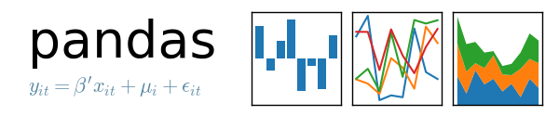
PROCESS
Data cleaning, merging with Jupyter:
Extract data from CSVs
Create dataframes with Pandas
Remove unnecessary columns
Rename columns to match other data sources
Merge data sets together to combine population, GDP, and lat, long data
Notes:
We used jupyter notebook to clean and merge most of our datasets.
We transformed downloaded CSV and API pulled JSON files to dataframes, renamed columns, and then merged the separate datasets.
We also decided to focus our analysis on decades, so we started at 1990, went to 2020, and removed years that don’t end in 0.
Steven

Slide 12


Process
Pulled location data from UN API
Used D3 JS to map locations
Stored cleaned, combined dataframes in Postgres
Flask accessed database to render findings
Powered both maps and their relevant features
Notes:
We pulled country location data from the UN API in order to inform our D3 powered maps.
We moved the cleaned and merged dataframes to a Postgres database to support the Flask powered visuals.
Steven

Slide 13

Process
We used Python, Matplotlib, Numpy, and SciPy to perform analysis on the data
Sorted the data into new data frames that would facilitate rate of change analysis
Calculate rate of change for Population & GDP
Calculate correlation between GDP and Population growth
Charts created with the use of the several dataframes
Imported Seaborn to add flair to the charts
Created many bar charts to show absolute values and growth over time
Used SciPy to do correlation analysis between population and GDP growth
Notes:
In order to calculate rates of both population and GDP change over time, we had to resort the dataframes and reset the index - something that confounded our team for a bit.
We then used a for loop to cycle through the data and recognize when a new country was the next index and reset the value to 1 and then do rate of change analysis for that country. This means that our first rate of change analysis begins at the year 2000 while our absolute values data presentations begin at 1990.
Used the several dataframes created to generate barcharts, line charts, and correlation analysis.
Steven

Slide 14
03
Creating The Database

Slide 15

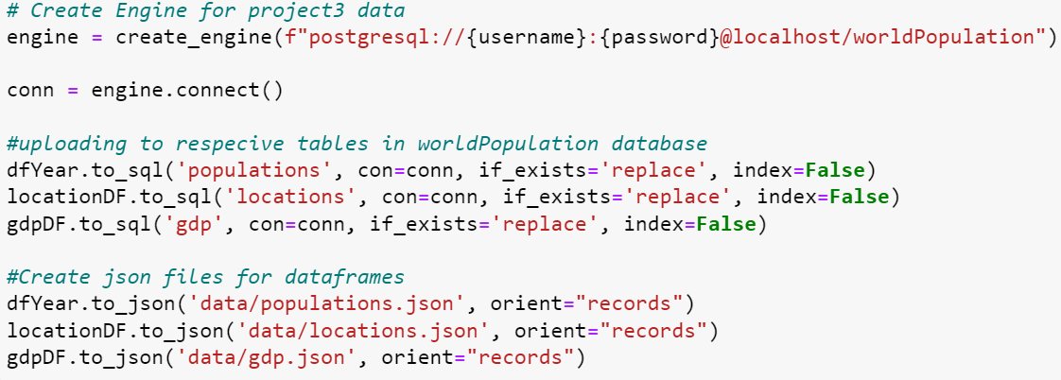
PROCESS
Database: worldPopulation
Creating engine
Connecting to database
Uploading using df.to_sql
SQL query to join tables
Notes:
Indra/Connor

Slide 16
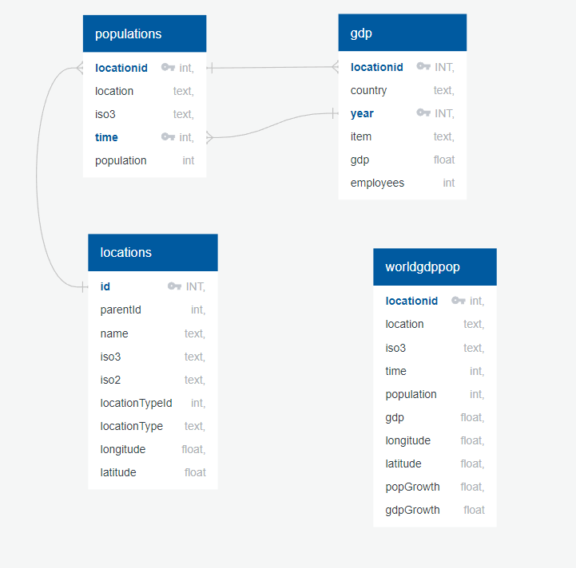
World Population - ERD
Database: worldPopulation
Tables:
populations
locations
Gdp
Worldgdppop
SQL Query:
Join populations, locations, and gdp tables
Create worldgdppop
Notes:
Indra/Connor

Slide 17
04
Data Analysis

Slide 18
POPULATION GROWTH OVER THE DECADES
2000
2020
1990
2010
Notes:
Hassan/Mohamed

Slide 19
TOP 3 COUNTRIES
POPULATION IN 2020
CHINA
1.40 BILLIONS
INDIA
1.38 BILLIONS
U.S.A
325 MILLIONS
Notes:
Hassan/Mohamed

Slide 20
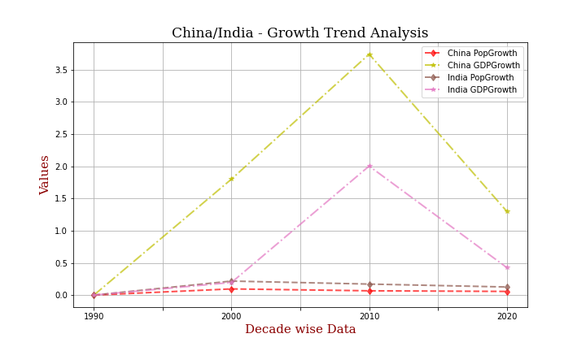
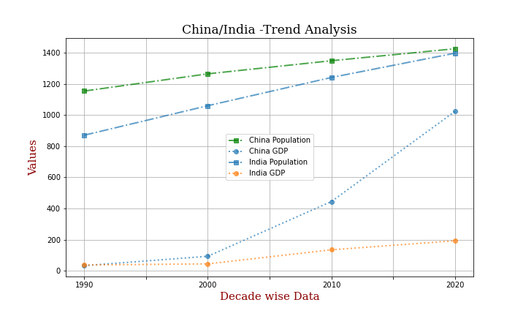
Conclusion of Data Analysis
Notes:
Hassan/Mohamed

Slide 21
THE MAIN CONCLUSIONS ARE…
India has a population growth of 12%
China has a population growth of only 6%
The top population growth countries have population growth above 40%
Notes:
Hassan/Mohamed

Slide 22
GDP & POPULATION GROWTH %
2020
2000
The correlation between Country population and GDP is -0.06
The correlation between Country population and GDP is -0.05
2010
1990
The correlation between Country population and GDP is -0.07
The correlation between Country population and GDP is -0.05
Notes:
The negative correlation coefficient in all 4 decades indicates that the GDP of the country decreases as its population increases
Hassan/Mohamed

Slide 23
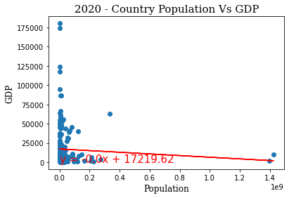
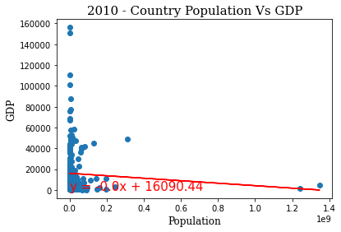
Correlation and Linear Regression
Notes:
Hassan/Mohamed

Slide 24
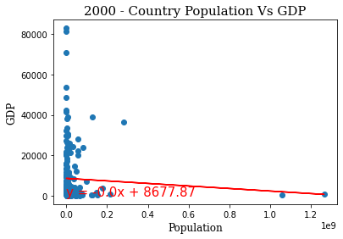
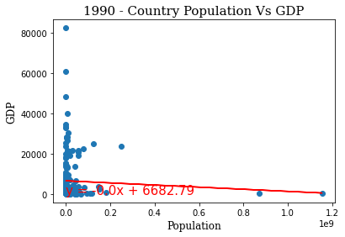
Correlation and Linear Regression
Notes:
The negative correlation coefficient in all 4 decades indicates that the GDP of the country decreases as its population increases.
Hassan/Mohamed

Slide 25
05
Visualizations

Slide 26
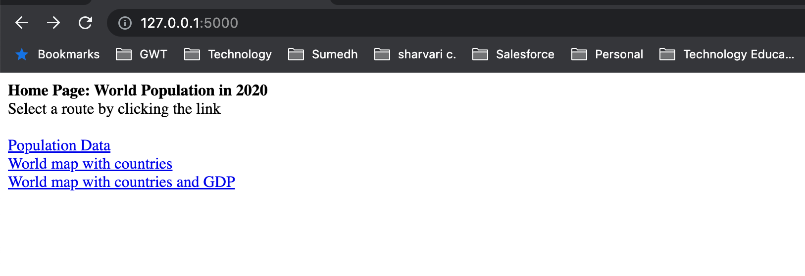
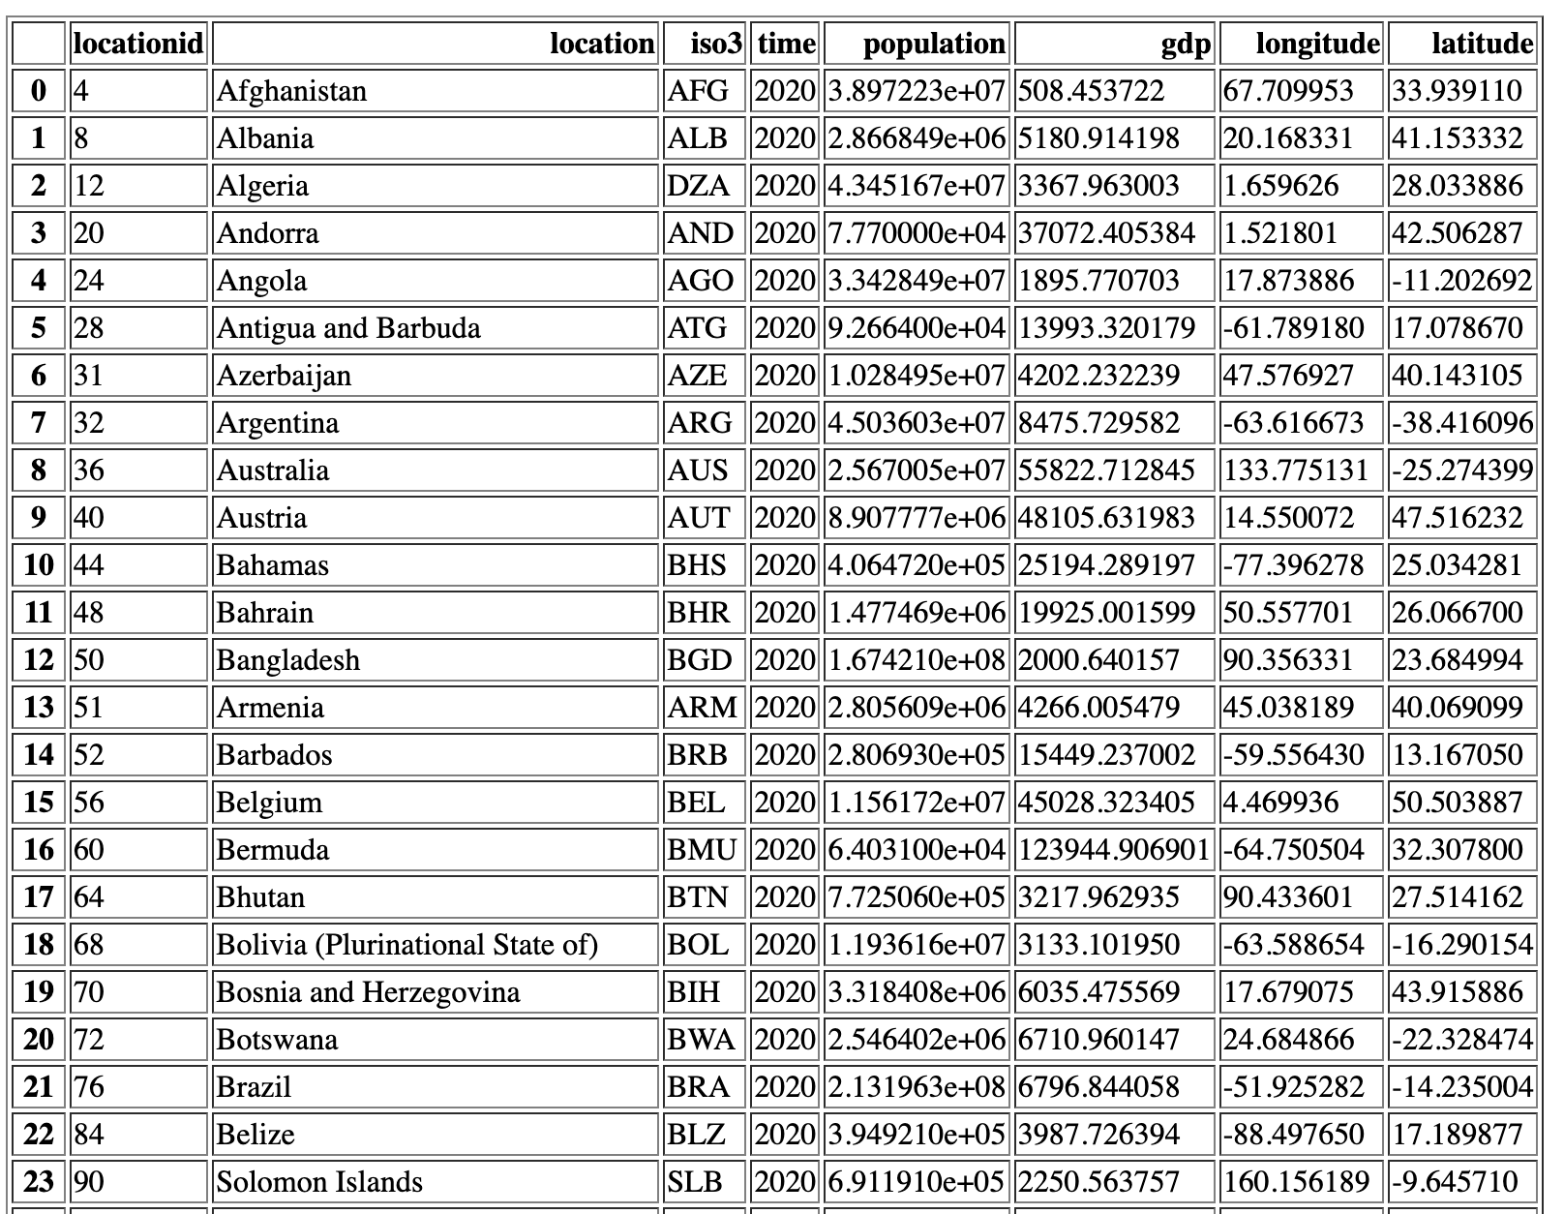
Flask API
A flask app that uses data from postgres and JS D3 and lodash libraries for visualization
Notes:
Subodh/Chris

Slide 27
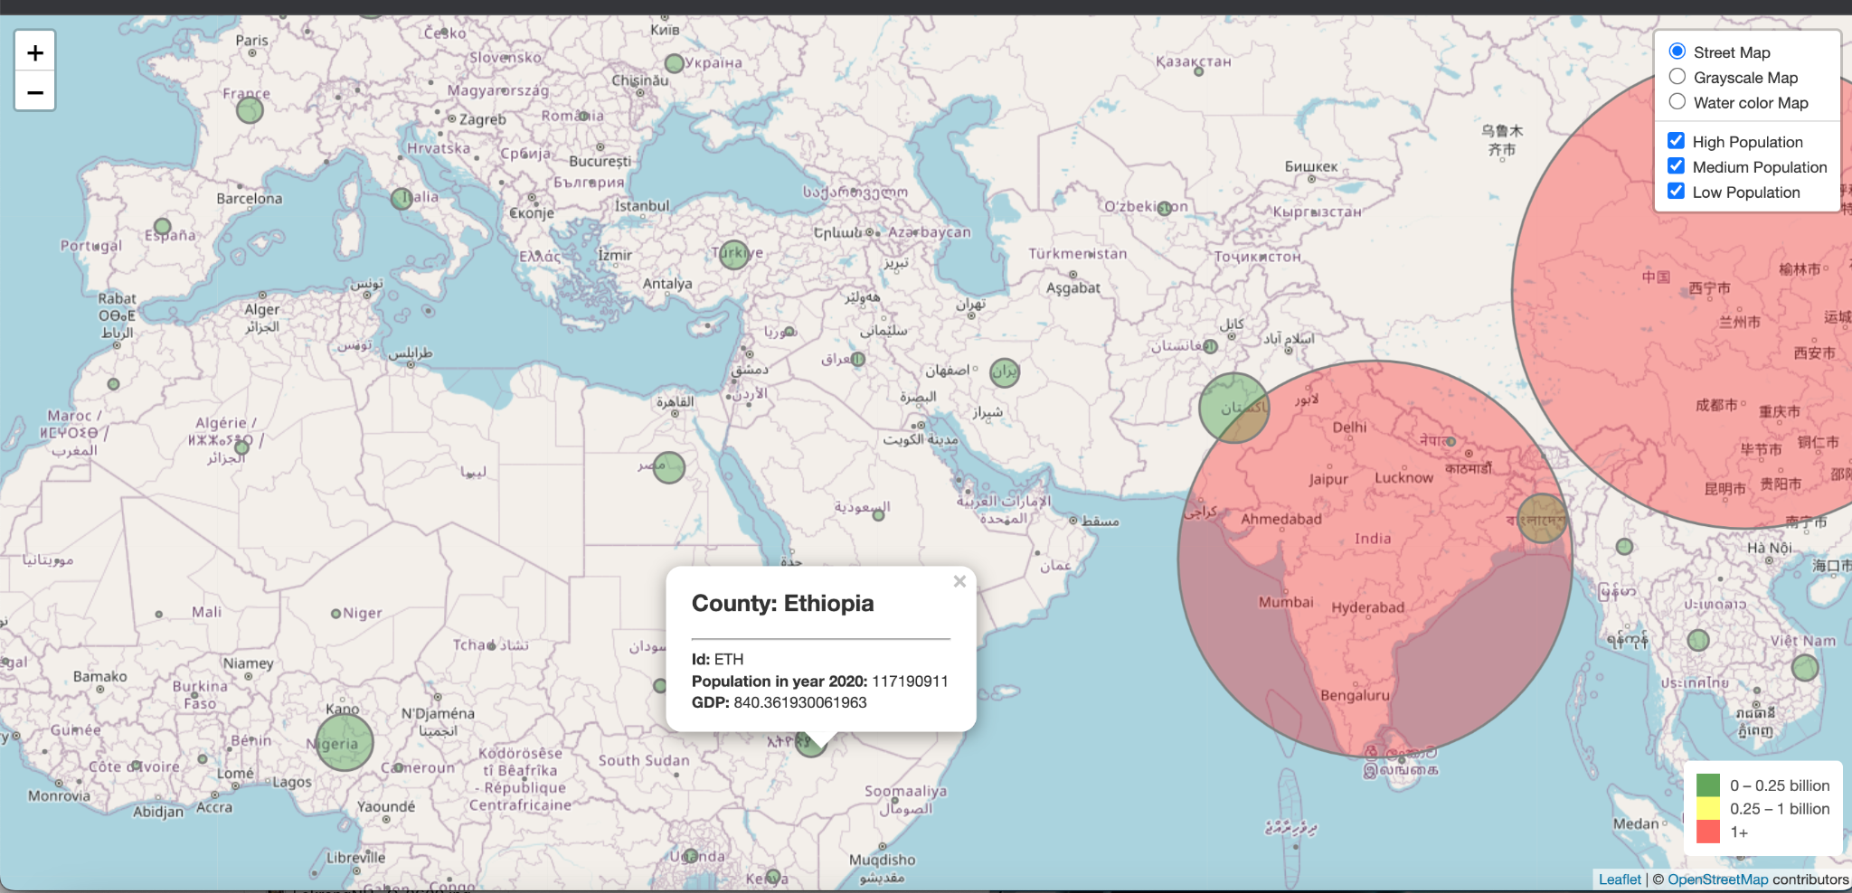
Flask API
Notes:
Subodh/Chris

Slide 28
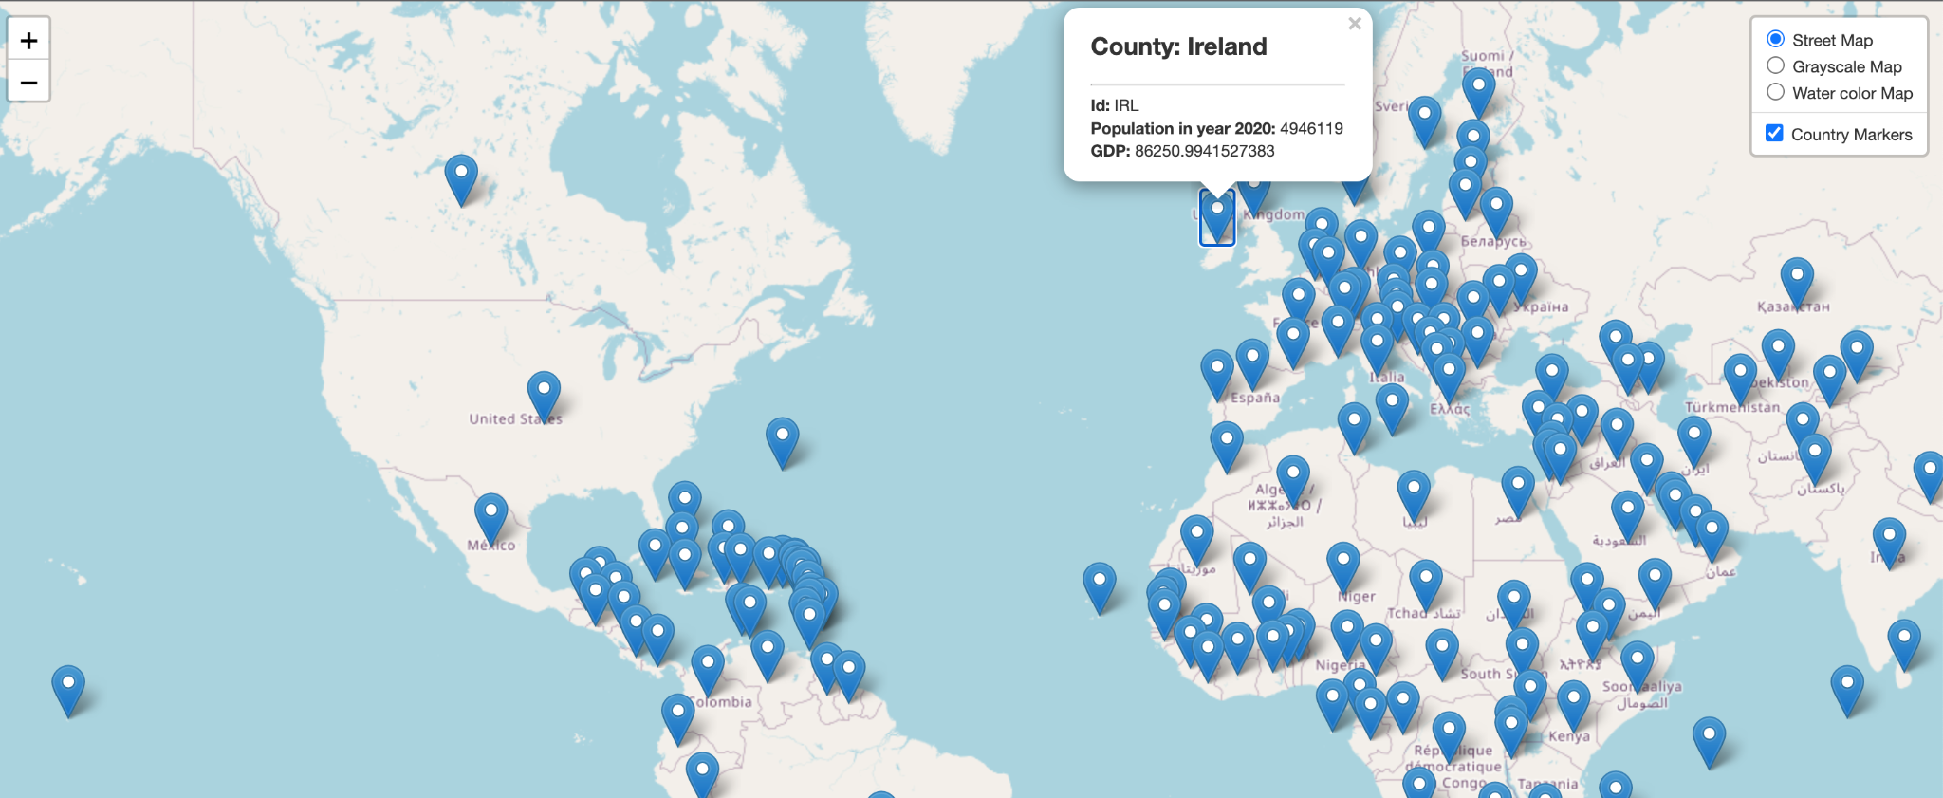
Flask API
Notes:
Subodh/Chris

Slide 29
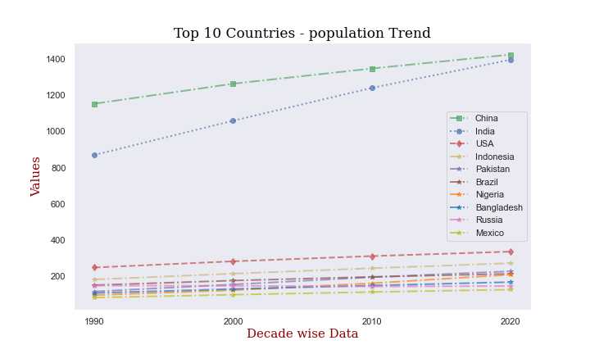
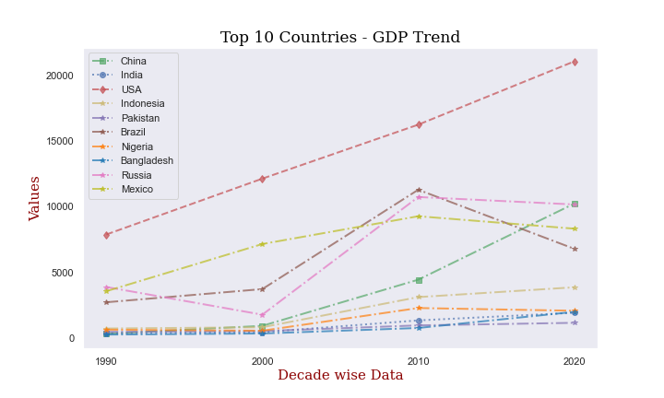
Trend Analysis of Top 10 populated Countries
From 2000 to 2010 - Increase of GDP in all top 10 countries
From 2010 to 2020 - Considerable increase of GDP in USA(+14,400) and China(+5700)
Top 3 populated country's GDP in 2020: China - 10229; India - 1931; USA - 63123
GDP went down in 2020 compared to 2010 in 4 top 10 countries - Nigeria(-207), Russia(-567), Mexico(-946) and Brazil(-4489)
World population as of 2020 - 7.75B. The Top 10 countries accounted for 58% of the world population.
The top 2 populated countries(China and India) contributed 36% of the world population.
Notes:
Connor

Slide 30
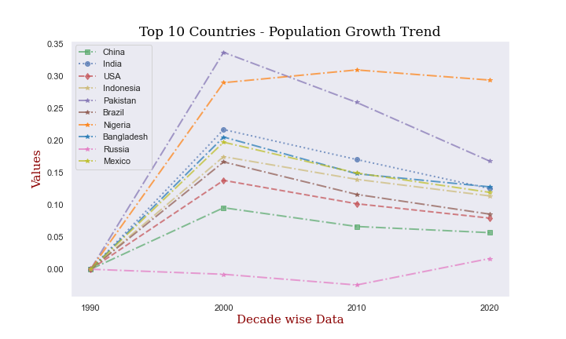
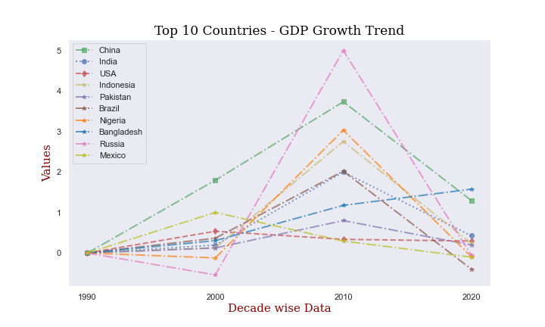
Trend Analysis of Top 10 populated Countries
2000 - 2010: Except USA and Mexico, all top 10 countries had increase in GDP growth
Bangladesh alone has a +ve gdp growth from 2010 to 2020.
USA's gdp growth has gone down only by 4% from 2010 to 2020
Russia's gdp growth % has gone down from 500% in 2010 to -5% in 2020
India's population growth has come down from 22% in 2000 to 13% in 2020
China's population growth has come down from 10% in 2000 to 6% in 2020
Except Russia, the population growth has come down from 2010 to 2020 for all other top 10 countries
Notes:
Connor

Slide 31
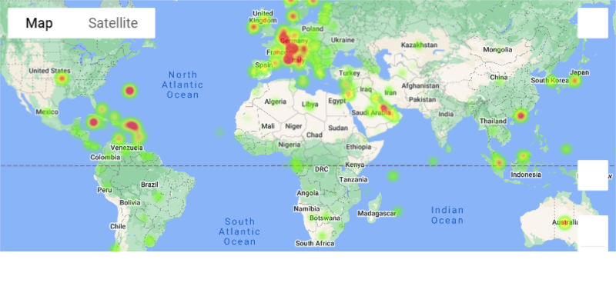
Heat Map of World GDP
Notes:
Connor

Slide 32
Conclusions of our Project
1.
2.
3.
4.
5.
6.
For the past 4 decades, China, India, USA & Indonesia have consistently, in this order, had the highest population
Over the decades, China has had a population growth of 6% while India has had a growth of 12%
At this rate, India will soon become the highest populated country in the world and China will move to #2
As of 2020, the top 10 most populated countries make up for 58% of the world population.
China and India, the top 2 most populated countries in the world, make up 38% of the world population
Except for Russia, the population growth has decreased for the 10 most populated countries in the world
Notes:
In conclusion, our analysis shows 9 main findings: China, India and Indonesia have had the highest population for the past 4 decades, Since China’s population growth is only 6% and India’s population growth is 12%, we can safely assume that India will soon become the most populous country. Also the top 10 countries make up 58% of the world population and the top 2 countries make up 38%. The population growth has decreased for the 10 most populated countries, with the exception of Russia.
Giovanna

Slide 33
Conclusions of our Project
7.
8.
9.
4 of the 10 most populated countries have decreased GDP comparing GDP between 2010 and 2020
Bangladesh alone has had positive GDP growth from 2010 to 2020
Our analysis indicates that the GDP of a country decreases as its population increases
Notes:
Between 2010 and 2020, the GDp has decreased in 4 of the top 10 countries. Bangladesh has had a positive gdp growth and finally
Giovanna

Slide 34
THANK
YOU!
Credits: This presentation template was created by Slides go, and it includes icons by Flaticon, infographics & images by Freepik
Notes:
Giovanna

